Slide 1

Lariat Car Rental Data Analysis
Presented : by Lati boka

Slide 2
Topics
Revenue
Overall
By car type
by location
By month
Net Revenue & Rental Frequency
By car type
By State
Loss
by car type
Strategy & Recommendation

Slide 3





Recommendations
Eliminate cars with loss of profit: XJ Series,
Add more profitable cars: Shelby have high profit but have low availability
Give promotions to boost revenue from Non-Airport branches
Open more airport branch's

Slide 4
Strategies
Strategy 1: Investigate factors that increase Net revenue
Strategy 2: Examine Rental frequency by location and car type
Strategy 3: Identify cars that loss money
Combined strategy

Slide 5
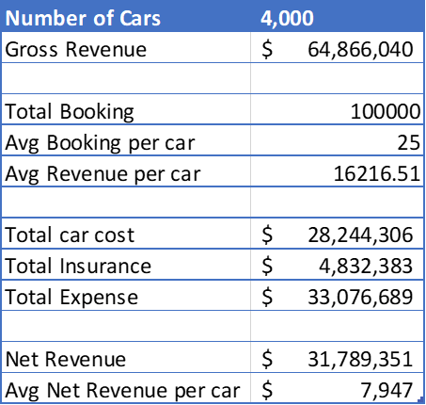
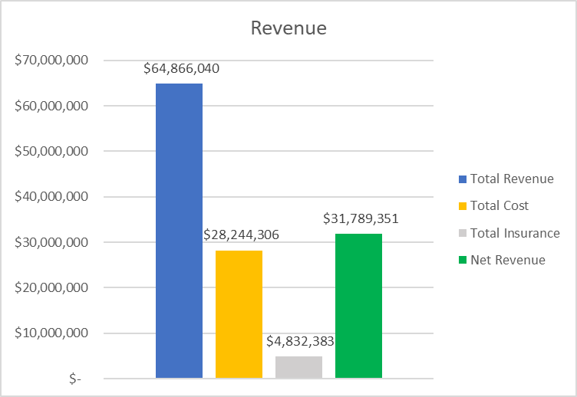
Overall Summary

Slide 6
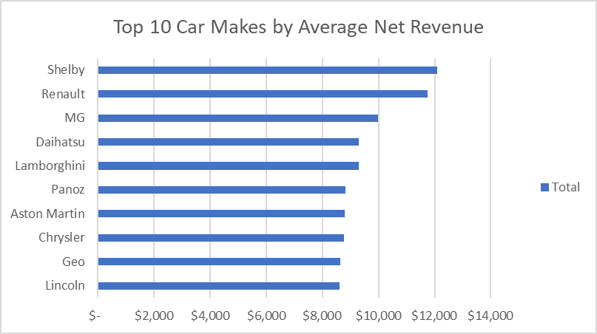
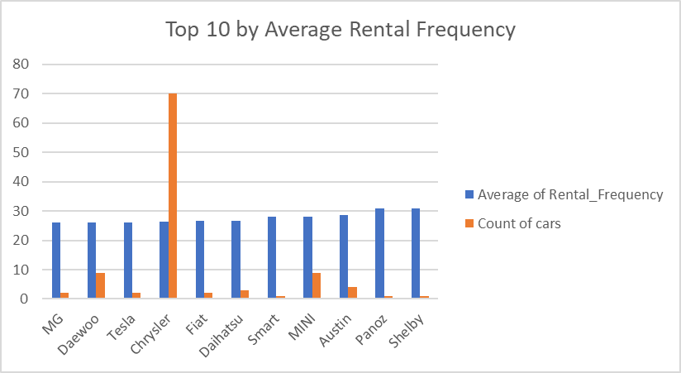
Strategy 1: Buy more Shelbs
Shelby:
high average net revenue: $12,087
lower availability: 1 car

Slide 7
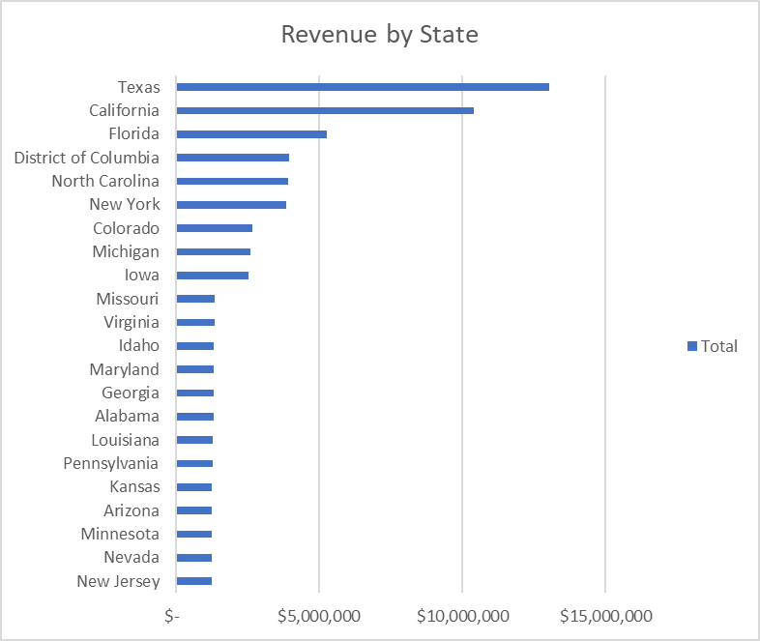
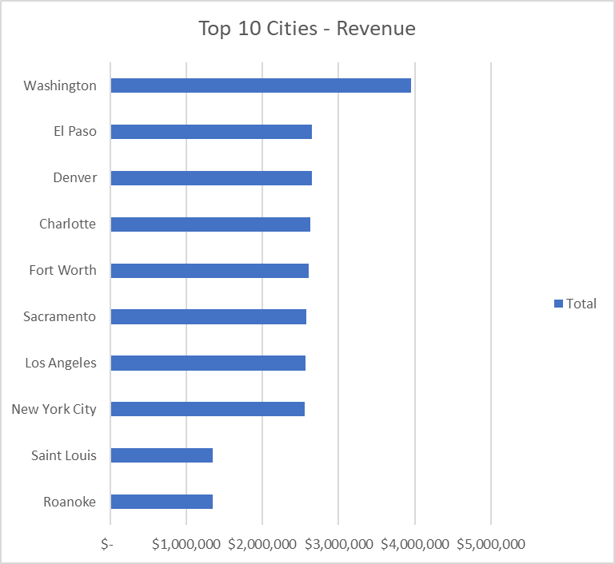
Strategy 2: Open more Airport branches for State of Texas and Washington Dc
Texas branch :$13,031,054
California branch: $10,391,989
Washington DC : $3,955,155

Slide 8
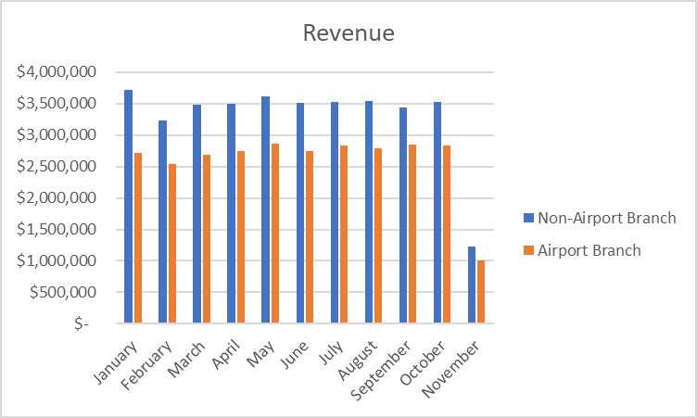
Strategy 2: Add More Airport Branches
Airport Branches are making more revenue consistently for each month
There are more Non- Airport branches 28
Increase more airport Branches 22

Slide 9
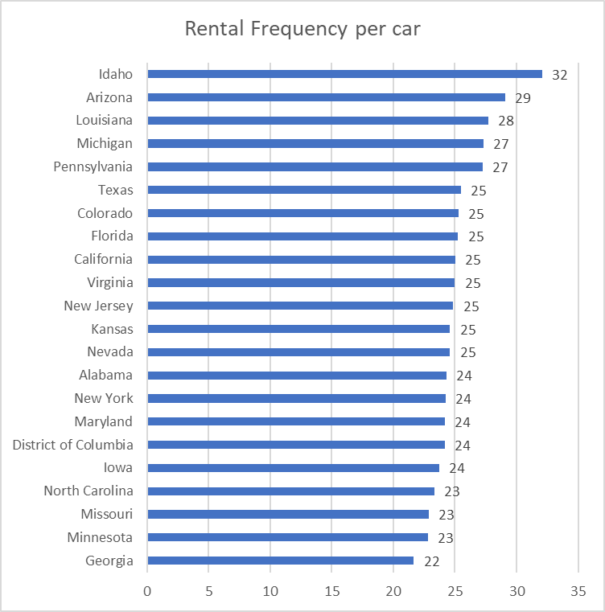
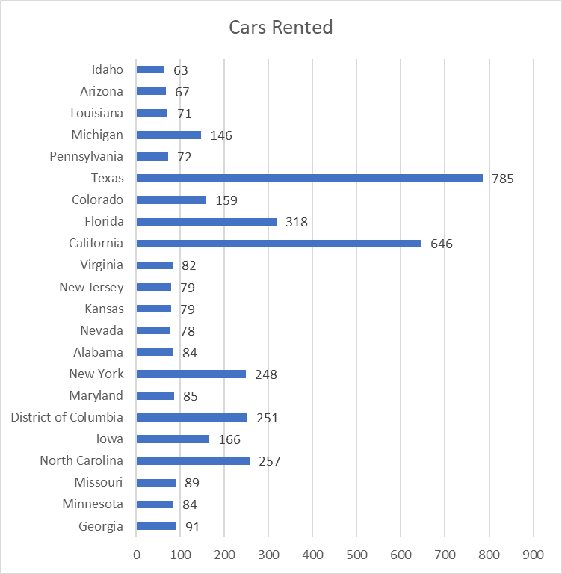
Strategy 3: Buy more cars for Idaho branchs
Idaho: highest booking rate per car
Idaho: low number of cars rented

Slide 10
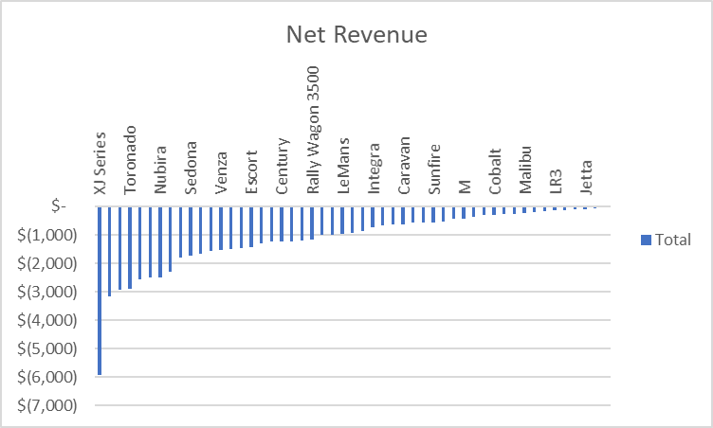
Strategy 3: The cars with loss of Profit
Cars with loss: 55
Total loss : $58,091
XJ Series cars losing the most
Eliminate XJ Series cars since losing big profit

Slide 11
Recommendation
Eliminate cars with loss of profit such as XJ Series,
1
Add more profitable cars: Shelby have high profit but have low availability
2
Give promotions to boost revenue from Non-Airport branches
3
Open more airport branch's
4

Slide 12

Questions

Slide 13


